Slide 1

Predicting Energy Consumption per Trip using Real-World EV Fleet Data
Machine Learning Final Project
by Anter Saadaoui

Slide 2
Motivation Behind the Project
Mobility is no longer a luxury but a necessity, understanding and optimizing the performance of electric vehicles (EVs) has become a pressing challenge.
Contributing to the future of green mobility by turning raw sensor data into actionable intelligence.

Slide 3
Dataset Information
Source: RWTH Aachen University- EV fleet trips (https://publications.rwth-aachen.de/record/979878)
Size: Over 27,300 observations.
Key Features: trip_id, distance, duration, speed_max, soc_start, soc_stop, etc.
Objective: analyzing real-world sensor data from multiple electric vehicles, to build robust predictive models capable of estimating energy consumption per trip.

Slide 4
What Did I Do?
1. Data Loading and Preprocessing
- Combine all fleet data from multiple “.parquet” files.
- Feature engineering and handling missing data.
- Calculate energy consumption (SoC_used) .
2. Modeling
- Train Random Forest and XGBoost models.
- Use GridSearchCV and RandomizedSearchCV for hyperparameter tuning.
3. Evaluation
- Evaluate models using MAE, RMSE, and R².
- Analyze feature importance to identify key drivers of energy use.
4. Conclusion & Next Steps
5. Ethical Considerations & Limitations

Slide 5
Business Problem
Fleet managers need to reduce energy consumption and operational costs.
Predicting energy usage per trip helps optimize fleet scheduling and improve energy efficiency.

Slide 6
ML Problem Formulation
We frame this as a supervised regression task:
Target: Energy consumption per trip (`SoC_used = soc_start - soc_stop`)
Features: distance, duration, speed_max, fleet_type, etc.
Goal: Build a model to predict `SoC_used`, and identify the key drivers of energy usage.

Slide 7
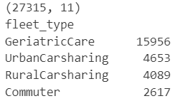
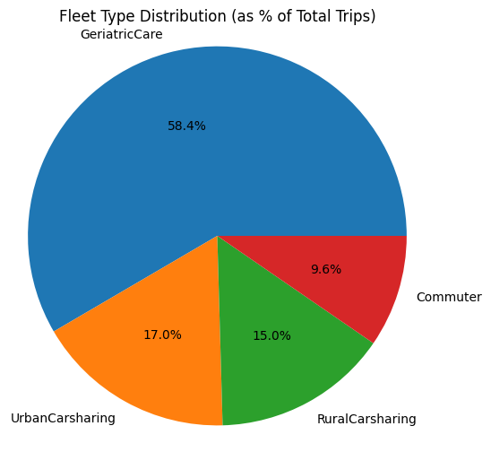
1. Data Loading and Preprocessing
Combined multiple .parquet files
See the Fleet distribution
# Display the shape of the combined dataset (rows, columns)
print(full_df.shape)
# Show the number of entries per fleet type
print(full_df["fleet_type"].value_counts())

Slide 8
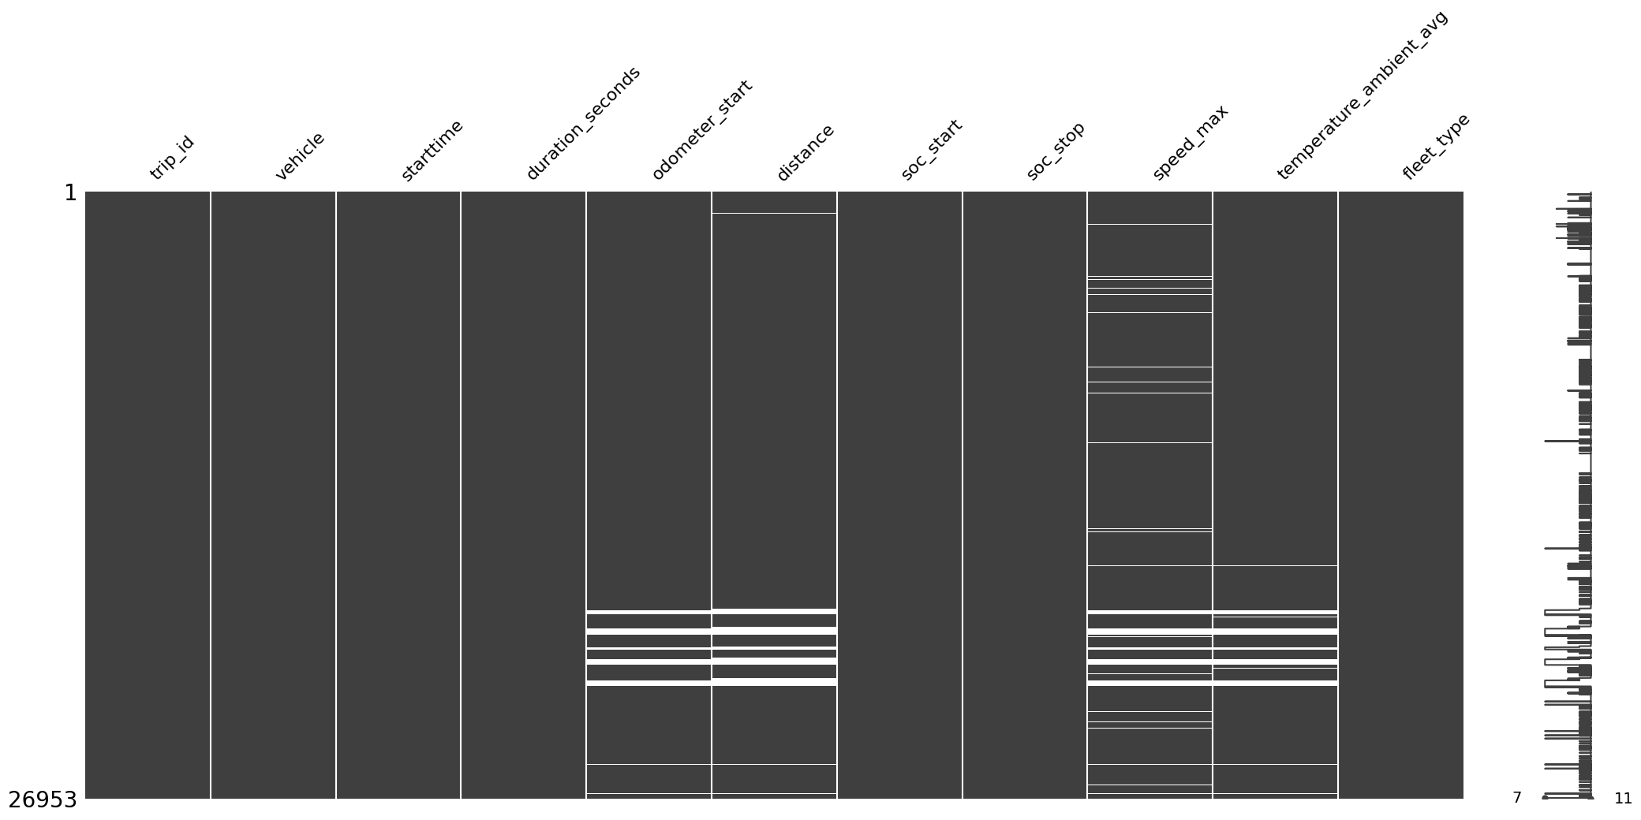
Handling missing values & outliers
full_df.describe()
Outliers
There is no outliers in all the columns except the duration_seconds. the max of duration_seconds is 7344269 S which is a bit more then 85 days. We suggest that is incorrectly entered and we drop all duration more then **8 hours** (Business hours).
Handling missing values
# white lines indicate missing values
msno.matrix(full_df)
# Display the plot
plt.show()

Slide 9
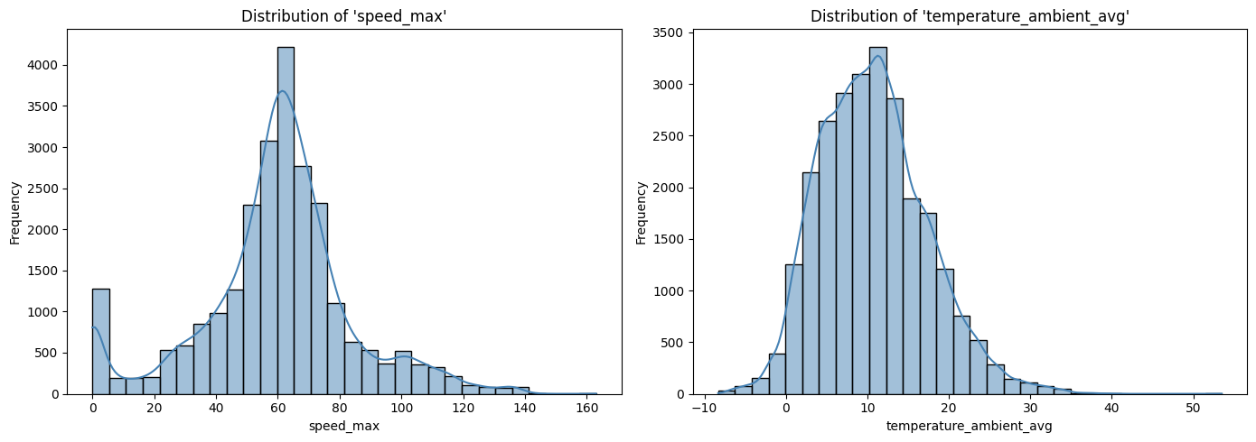
✅ Dropping rows with missing distance or odometer_start: They are key variables for trip-level analysis.
✅ Median or mean imputation for speed_max and temperature_ambient_avg: This approach helps to preserve signal but we must plot them to see the distribution and decide if we use median or mean imputation.
speed_max is clearly skewed to the right with a suspicious spike at zero, so using the median is the safest choice to avoid distortion.
Temperature_ambient_avg shows a fairly normal shape with only slight skewness, making the mean a reasonable option for imputation but to get more robustness we use also the median imputation.

Slide 10
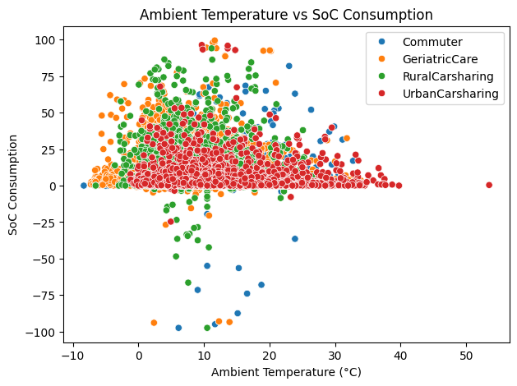
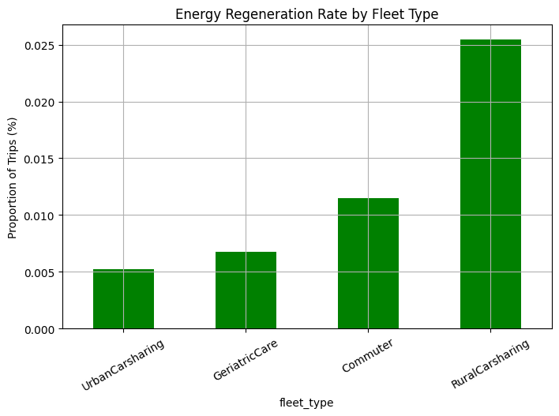
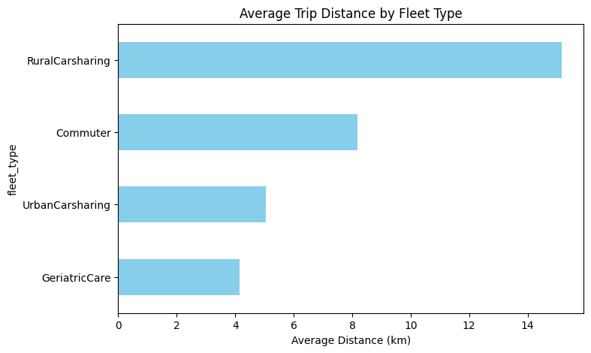
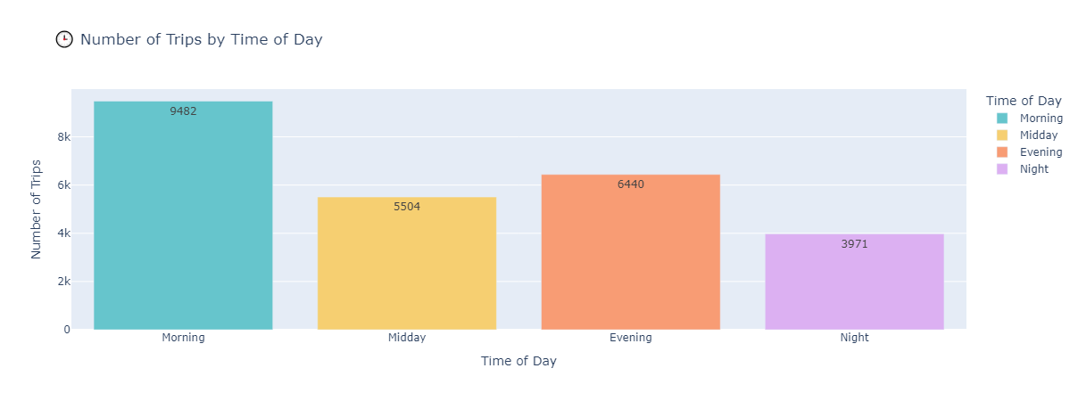
Feature engineering (trip efficiency, temperature, etc.)

Slide 11
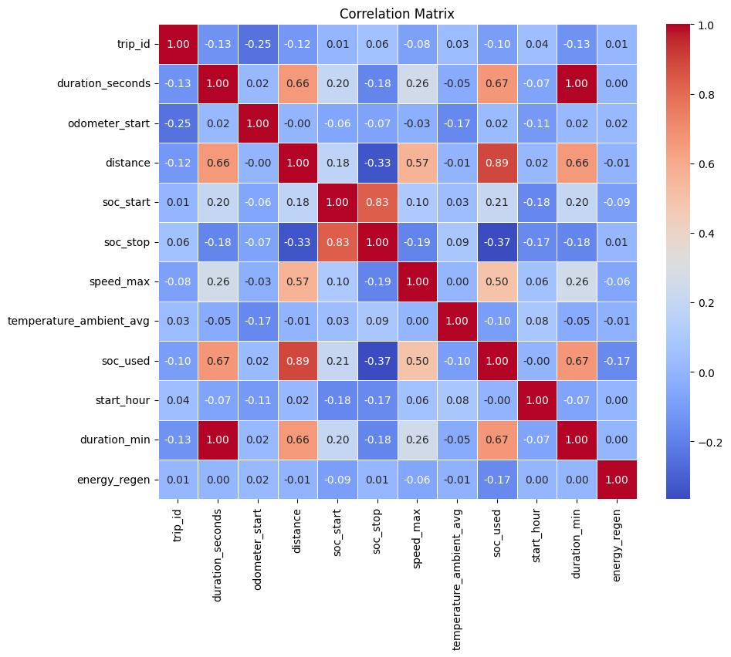
Created new target: SoC_used
# Calculate SoC used during each trip
df['soc_used'] = df['soc_start'] - df['soc_stop']
Correlation matrix
SoC_used is highly correlated with duration_seconds, distance and speed_max. It suggest that driving behavior plays a significant role in EV performance and energy usage.

Slide 12
Define the features (independent variables) and target (dependent variable)
features = ['distance', 'speed_max', 'duration_seconds', 'fleet_type']
target = 'soc_used'
Create the feature matrix X (input data) and the target vector y (output variable)
X = df[features]
y = df[target]
We apply One-Hot Encoding to the categorical variable fleet_type
# Apply One-Hot Encoding to the categorical column 'fleet_type'
X_encoded = pd.get_dummies(X, columns=['fleet_type'], drop_first=True)

Slide 13
2. Modeling
Models: XGBoost, Random Forest
Hyperparameter tuning (GridSearchCV, RandomizedSearchCV )
Metrics: MAE, RMSE, R²
Why?
We choose tree-based ensemble models (XGBoost and Random Forest) due to their :
Robustness to multicollinearity
Ability to handle non-linear relationships
Interpretability via feature importance

Slide 14
Models: XGBoost
We define and train an XGBoost Regressor model
MAE : 1.523
RMSE : 4.453
R² : 0.806
We perform a search for the best hyperparameters for the XGBoost model using GridSearchCV
Best hyperparameters found:{'learning_rate': 0.2, 'max_depth': 7, 'n_estimators': 300}
MAE (best XGBoost model): 1.313
RMSE (best XGBoost model): 4.153
R² (best XGBoost model): 0.831

Slide 15
Models: Random Forest
We define and train a Random Forest model.
As we see before our dataset is imbalanced so we add sample_weight.
RMSE: 4.279193284311862
We perform a search for the best hyperparameters for the Random Forest model using RandomizedSearchCV while correcting for target imbalance using sample weighting :
Best RF Model Parameters:{'n_estimators': 100, 'min_samples_split': 2, 'min_samples_leaf': 1, 'max_depth': 30}
MAE (best Random Forest model): 1.265
RMSE (best Random Forest model): 4.277
R² (best Random Forest model): 0.821

Slide 16
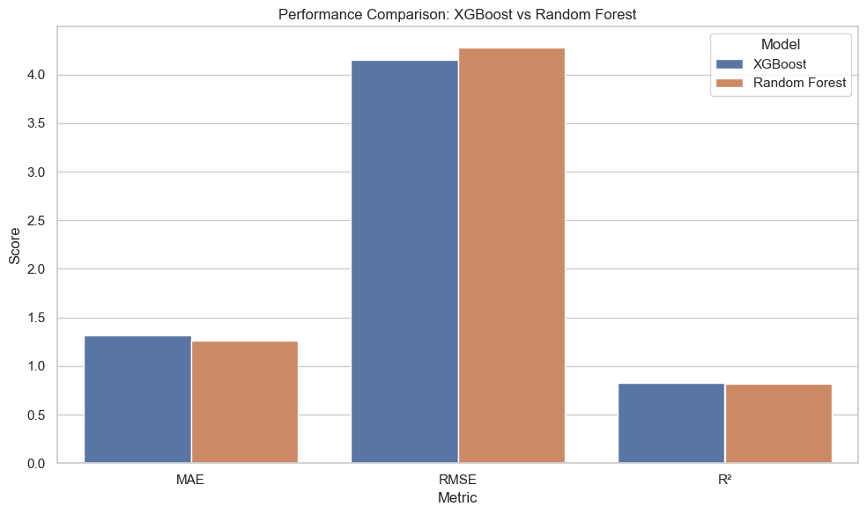
3. Evaluation
Distance, trip duration, and fleet type strongly impact SoC_used.
Temperature and max speed also relevant.
Feature importance helped explain energy consumption patterns.
Model | MAE | RMSE | R²
XGBoost | 1,313208 | 4,153112 | 0,831008 (83,1%)
Random Forest | 1,264512 | 4,277300 | 0,820751 (82,0%)

Slide 17
Both models predict with very close average error.
XGBoost slightly better at penalizing large errors, but both explain ≈ 83 % of variance and it is excellent fit.
The differences are small, so choosing either model is defensible but with preference to XGBoost model.

Slide 18
Conclusion & Next Steps
The goal was not limited to achieving optimal model performance but centred on designing a reproducible and technically sound data science pipeline.
This project demonstrated that predicting energy consumption per EV trip is feasible and can achieve high accuracy using real-world fleet data.
Trip duration and distance are the strongest predictors of energy usage.
Temperature and fleet_type also play a significant role, indicating the importance of context-aware fleet planning.

Slide 19
To improve generalizability and practical impact:
Include more environmental variables (e.g., elevation, road type, traffic).
Extend the dataset to cover battery degradation and longer-term usage.
Test on multiple seasons and extreme weather conditions.

Slide 20
4. Ethical Considerations & Limitations
Privacy concerns: The dataset contains detailed driving behaviour. Using this data beyond energy optimization ( insurance scoring) may raise ethical questions.
Fairness: Some fleet types are underrepresented, potentially biasing the model toward dominant vehicle types.
Generalization: The dataset reflects specific conditions (region, time). Results can not generalize to other fleets or geographies without retraining.

Slide 21
Ethical Use of LLM (particularly ChatGPT)
We used LLM's ( particularly ChatGPT 4.1 by OpenAI) to:
Markdown explanations and styling.
Summarize complex outputs.
Help project structure sections, translation and correct grammar.
No code or analysis was directly copied. All results were manually reviewed and interpreted by me.
Further appreciation is extended to the developers and contributors of open-source libraries and documentation (such as **Scikit-learn**, **XGBoost** and **Pandas**,.......).

Slide 22
Thank you!

